Slide 1

EVENT MANAGEMENT
DATABASE
GROUP - 5
Ankit Singh
Ashwini Somani
Chintan Agrawal
Manisha Nakawe
Nidhi Dahiya
Priya Saraf

Slide 2
AGENDA
Database Purpose
Business Rules
Entities
Workflow
ERD
SQL DDL
Data Visualization & Views
Data Encryption
Functions and Computed Columns
Trigger
Conclusion
Scope for Future improvements

Slide 3
EVENT MANAGEMENT DATABASE PURPOSE
Involves overseeing all logistics for an event, whether a birthday, wedding, or any organized gathering.
The heads of event management companies, managers, and staff are among the system’s primary users.
The database that we designed not only digitalizes the booking of orders and provides client convenience, but it also digitalizes the firm's functions

Slide 4
BUSINESS RULES
One vendor can provide only one service on one vendor_id. If the vendor has multiple services to offer, he/she should have one vendor_id per service.
One Booking_id can have only one event. If a customer has to book multiple events, then multiple bookings will be made i.e., one booking_id for each event.
One payment can be done against one invoice. There cannot be multiple payments i.e payment in installments is not allowed.
Customers can choose from a list of predefined packages and cannot customize the services in those packages.
The customer should choose an event from the predefined list of events.

Slide 5
ENTITIES: 18
Manager
Employee
Customer
Venue
Event
Package
Vendor
Photographer
Caterer
Makeup Artist
Performer
Transportation
Decoration
Equipment
Booking
Invoice
Payment
Customer Feedback

Slide 6







WORKFLOW
Customer
Sales-Person
Packages
Vendors
Customer Feedback
Payment
Event

Slide 7
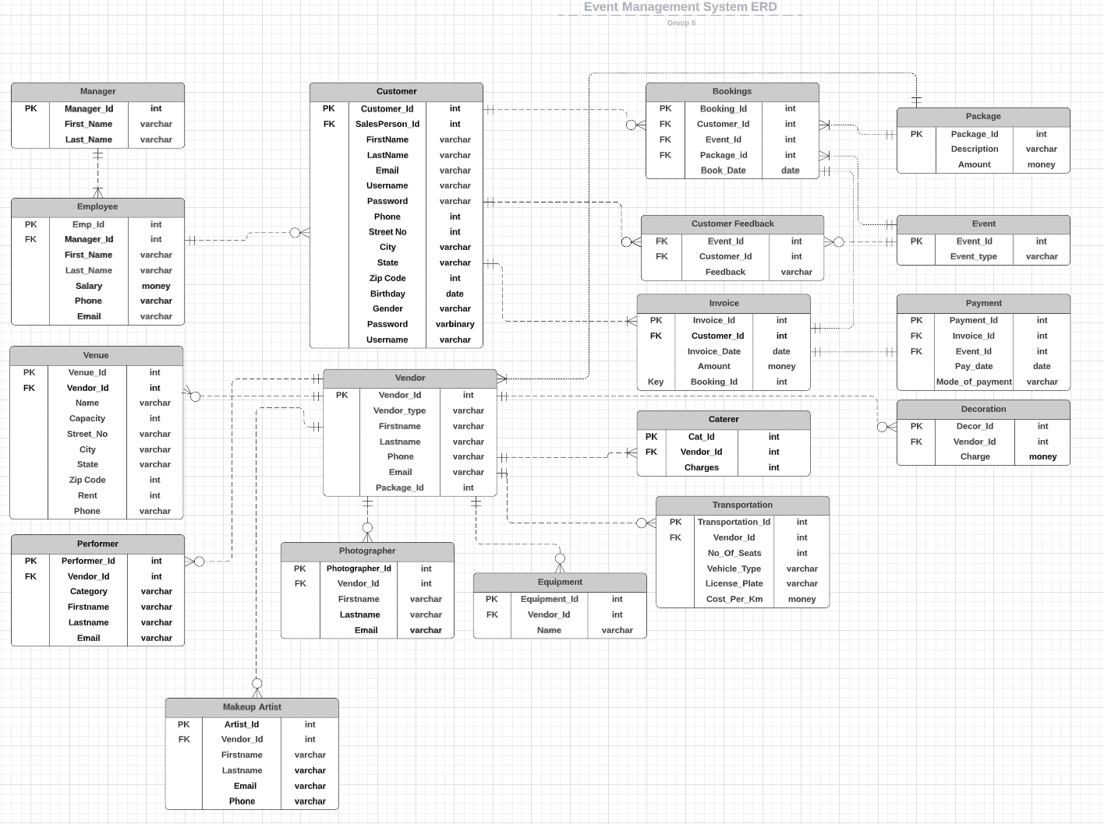
ENTITY RELATIONSHIP DIAGRAM

Slide 8
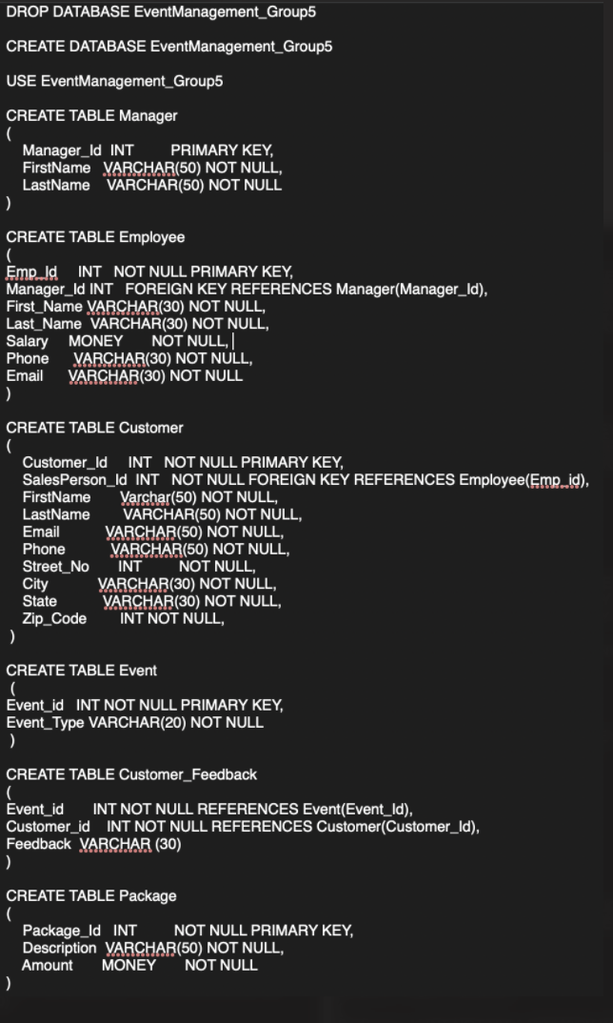
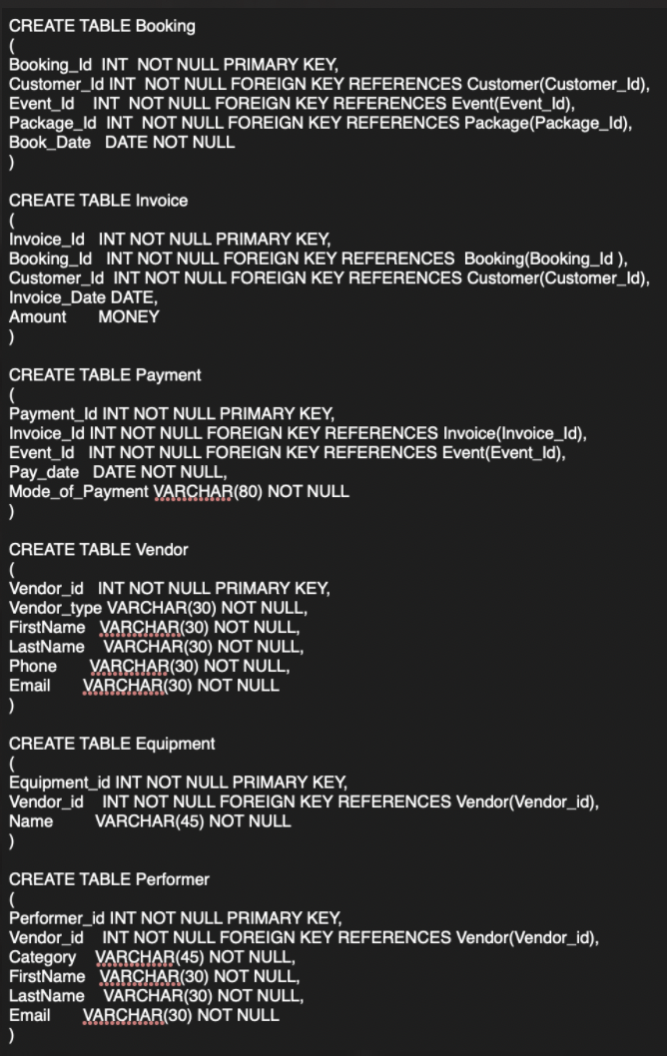
SQL DDL

Slide 9
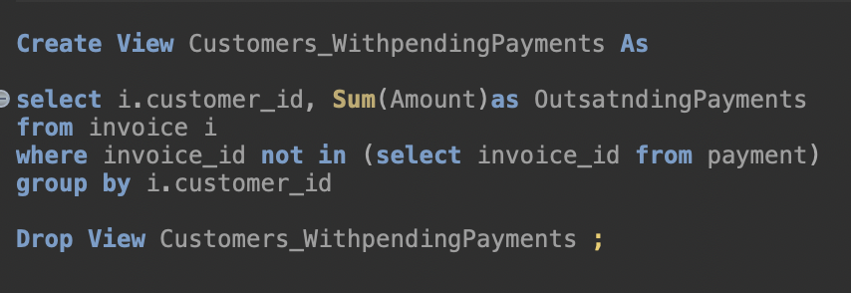
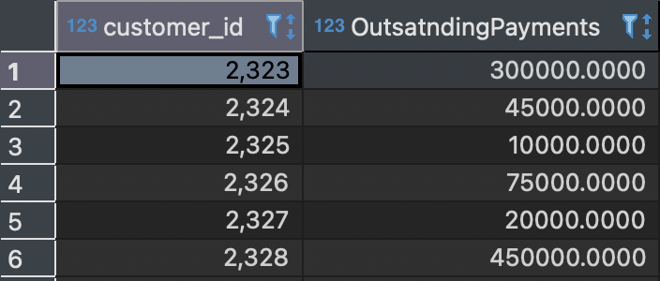
VIEWS FOR REPORTING
VIEW 1: Customers With Pending Payments
Purpose: To identify customers

Slide 10
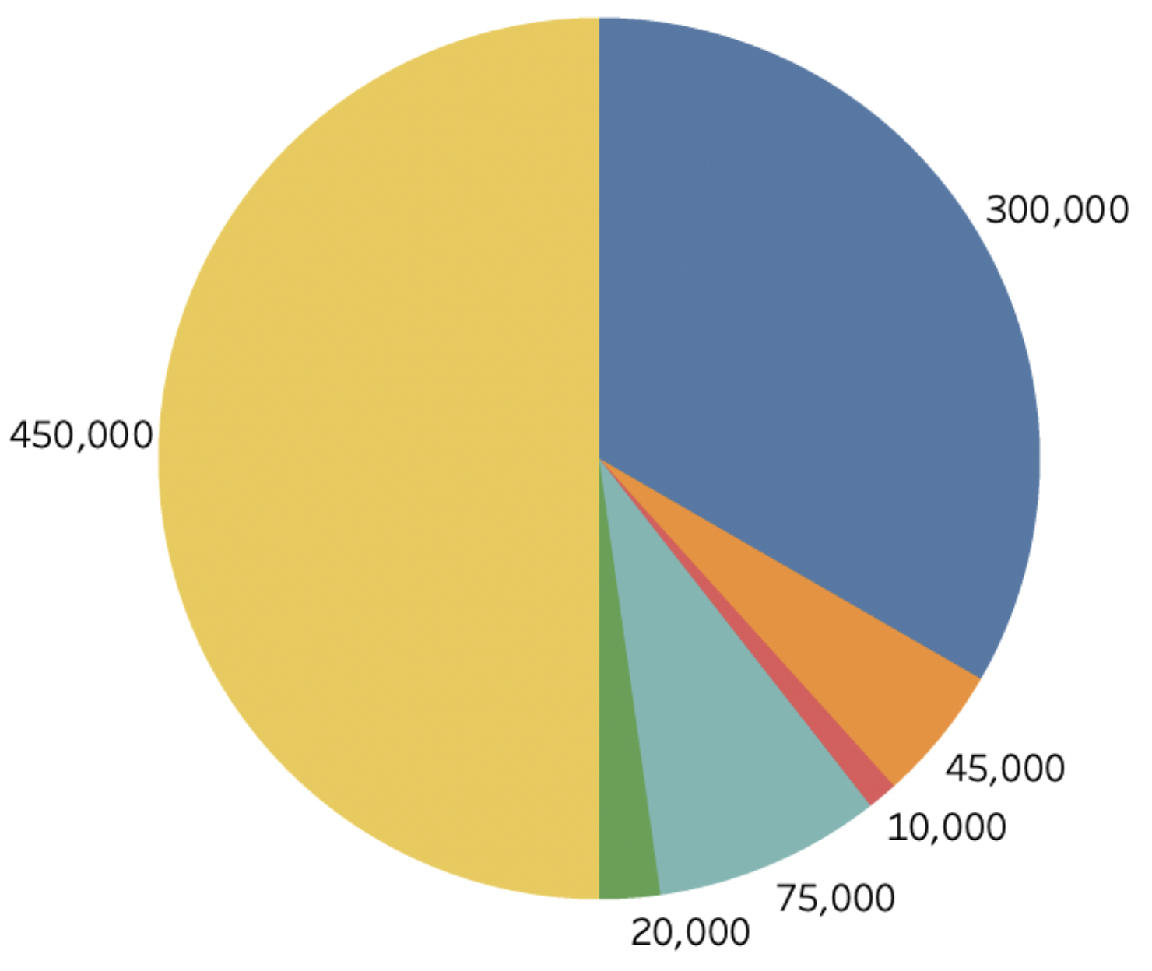
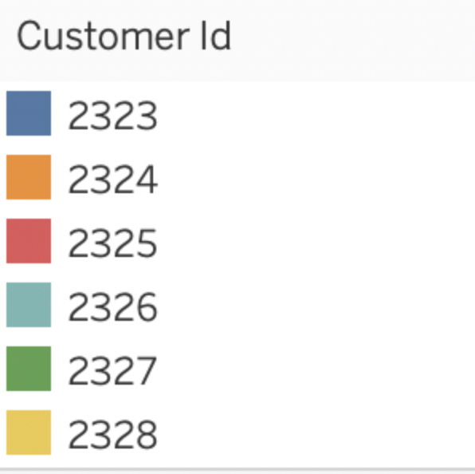
CUSTOMERS WITH PENDING PAYMENTS AND
THEIR AMOUNT

Slide 11
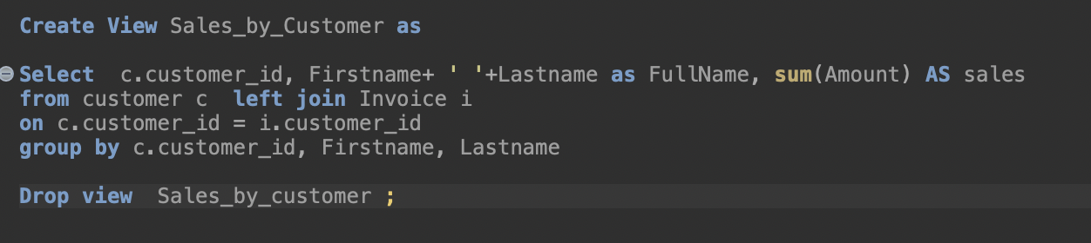
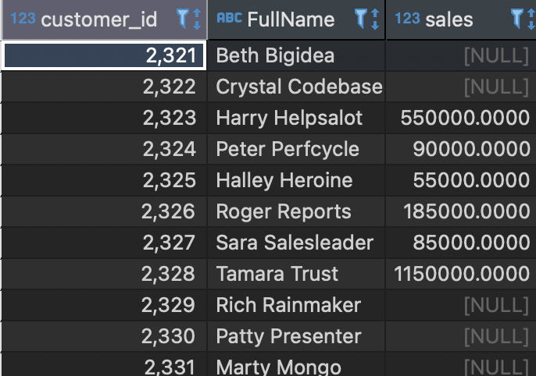
VIEWS FOR REPORTING VIEW 3: SALES BY CUSTOMER Purpose: To report sales from each customer

Slide 12
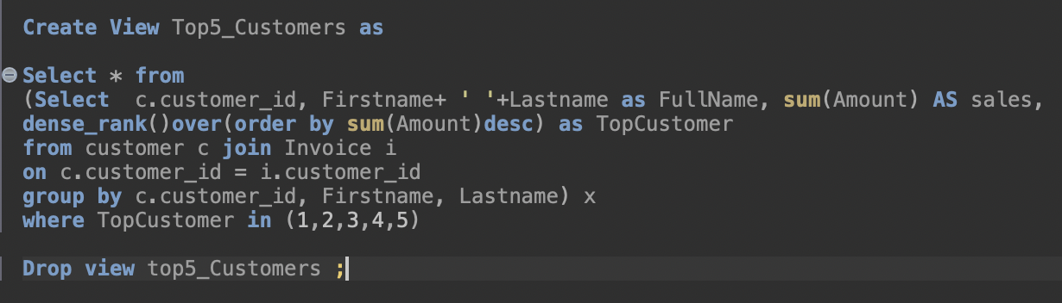
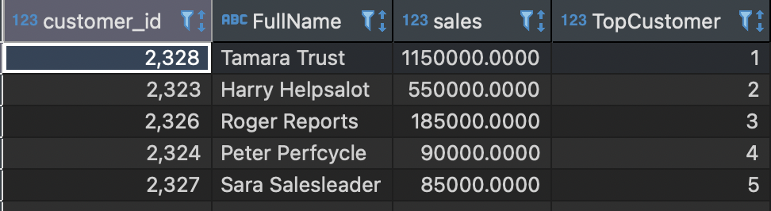
VIEWS FOR REPORTING VIEW 2: TOP 5 CUSTOMERS Purpose: To Identify Top 5 Customers

Slide 13
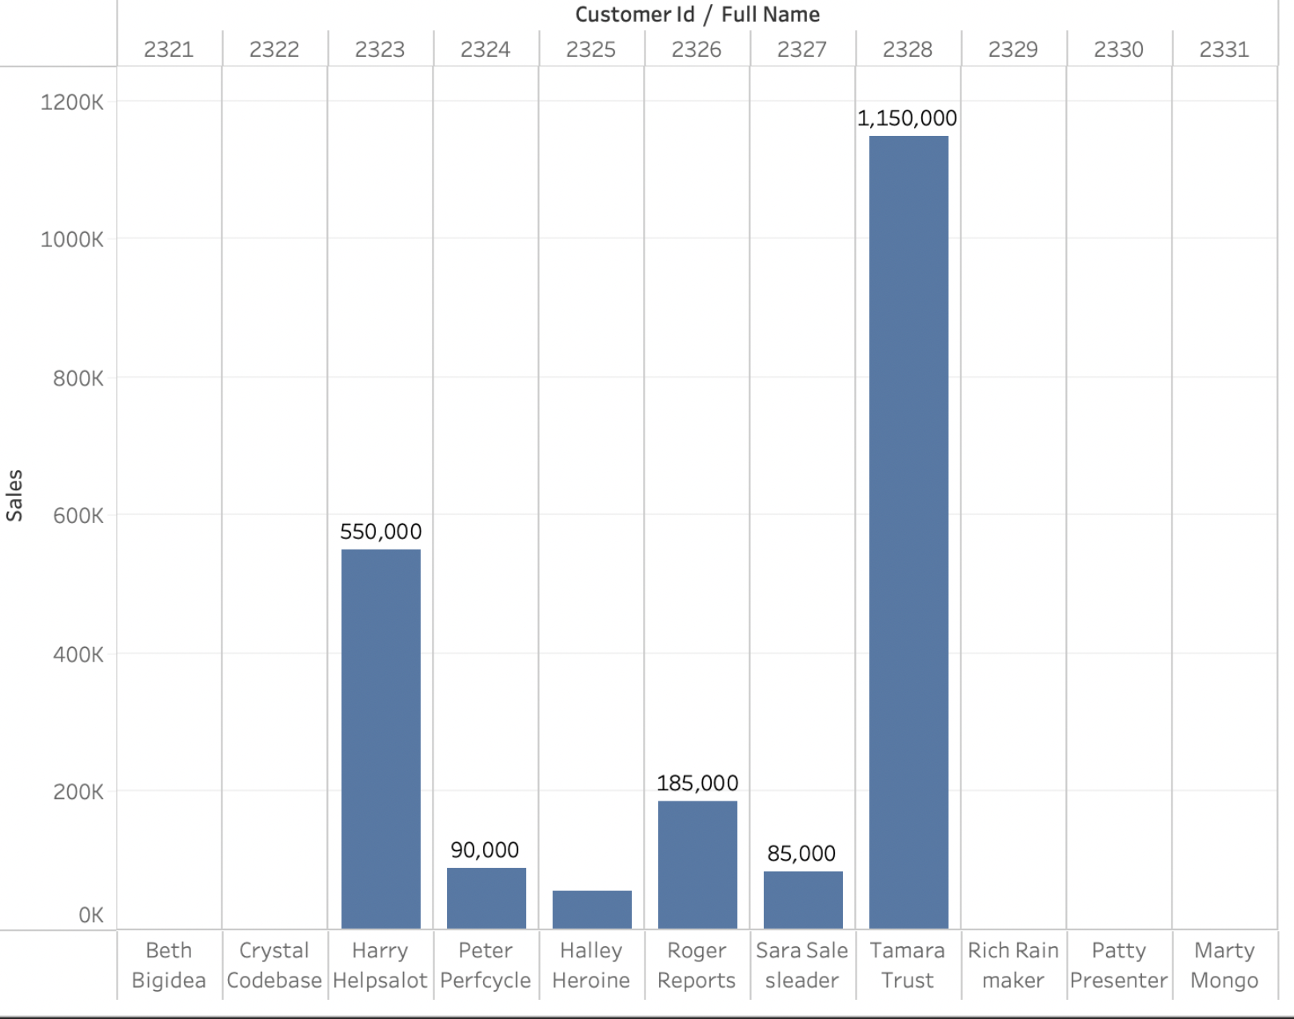
TOP 5 CUSTOMERS/ SALES BY EACH CUSTOMER

Slide 14
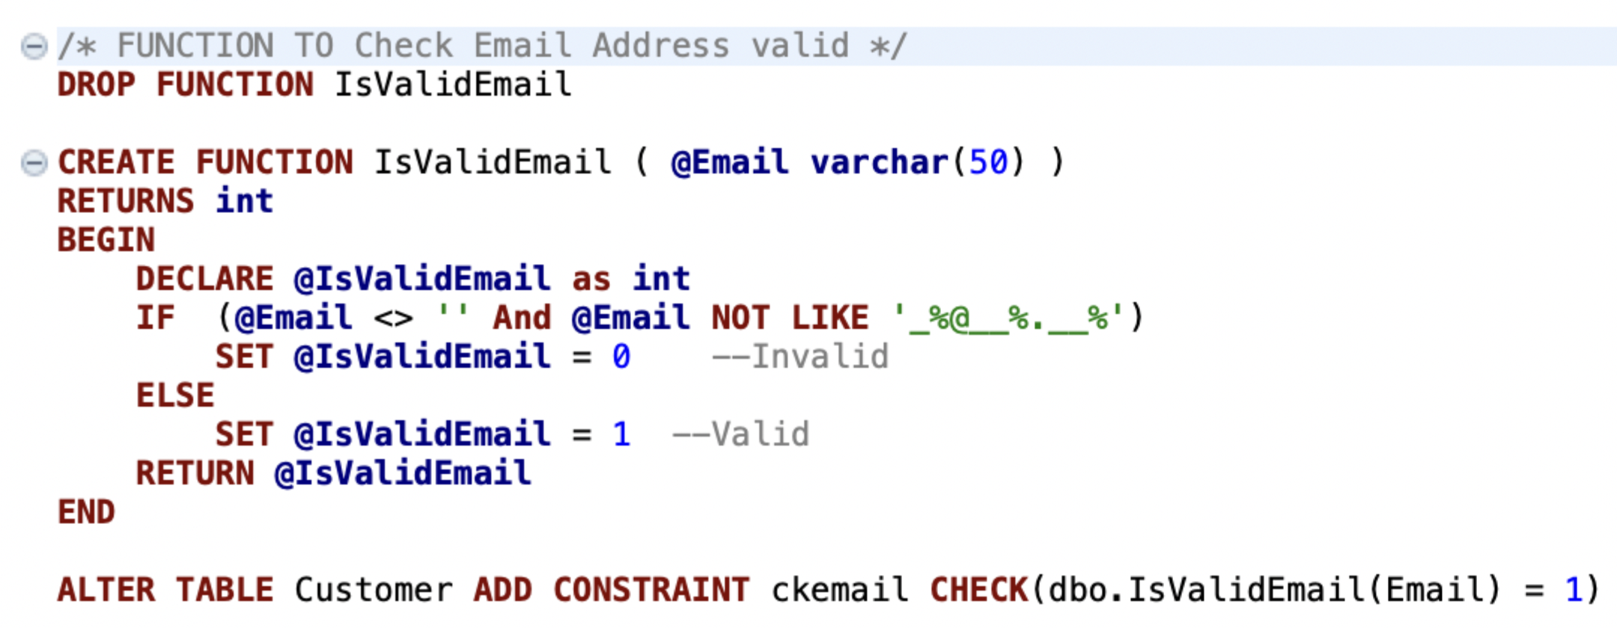
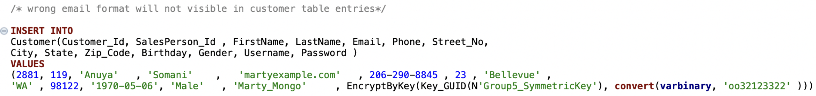
TABLE LEVEL CHECK CONSTRAINTS USING FUNCTION
To prohibit the customers from entering incorrect email IDs

Slide 15
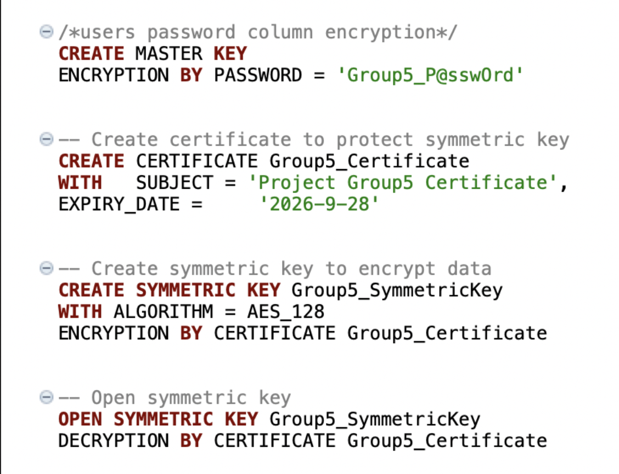
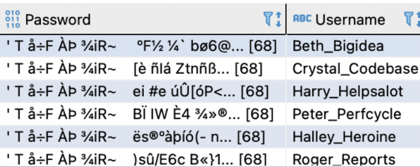
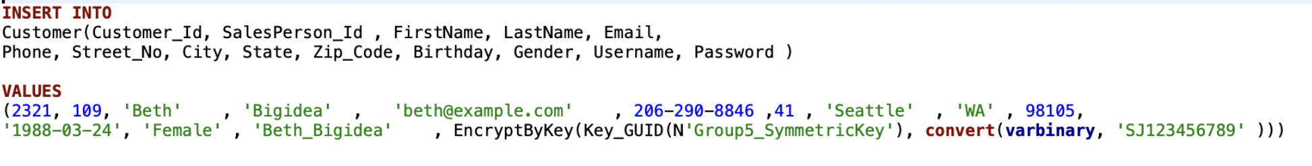
COLUMN DATA ENCRYPTION ON
PASSWORD

Slide 16
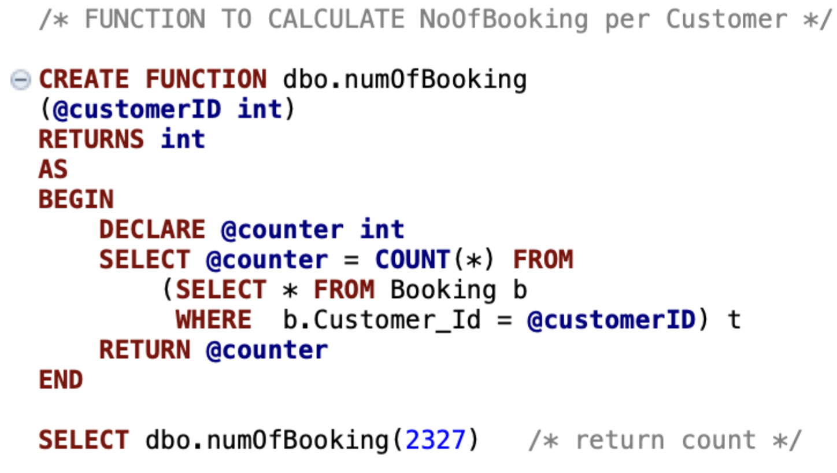
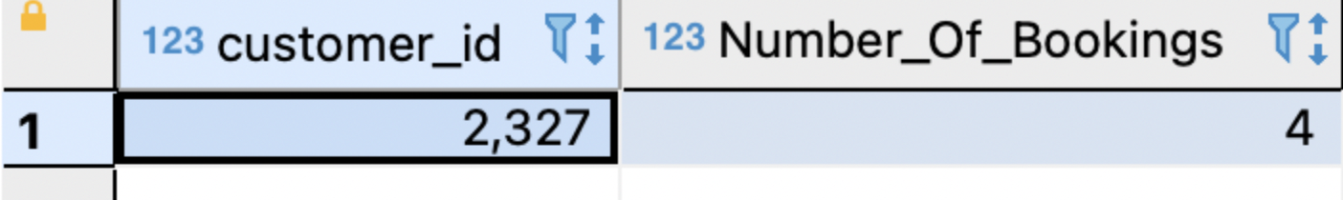
FUNCTION TO CALCULATE NO. OF BOOKINGS
To calculate the number of bookings per Customer

Slide 17
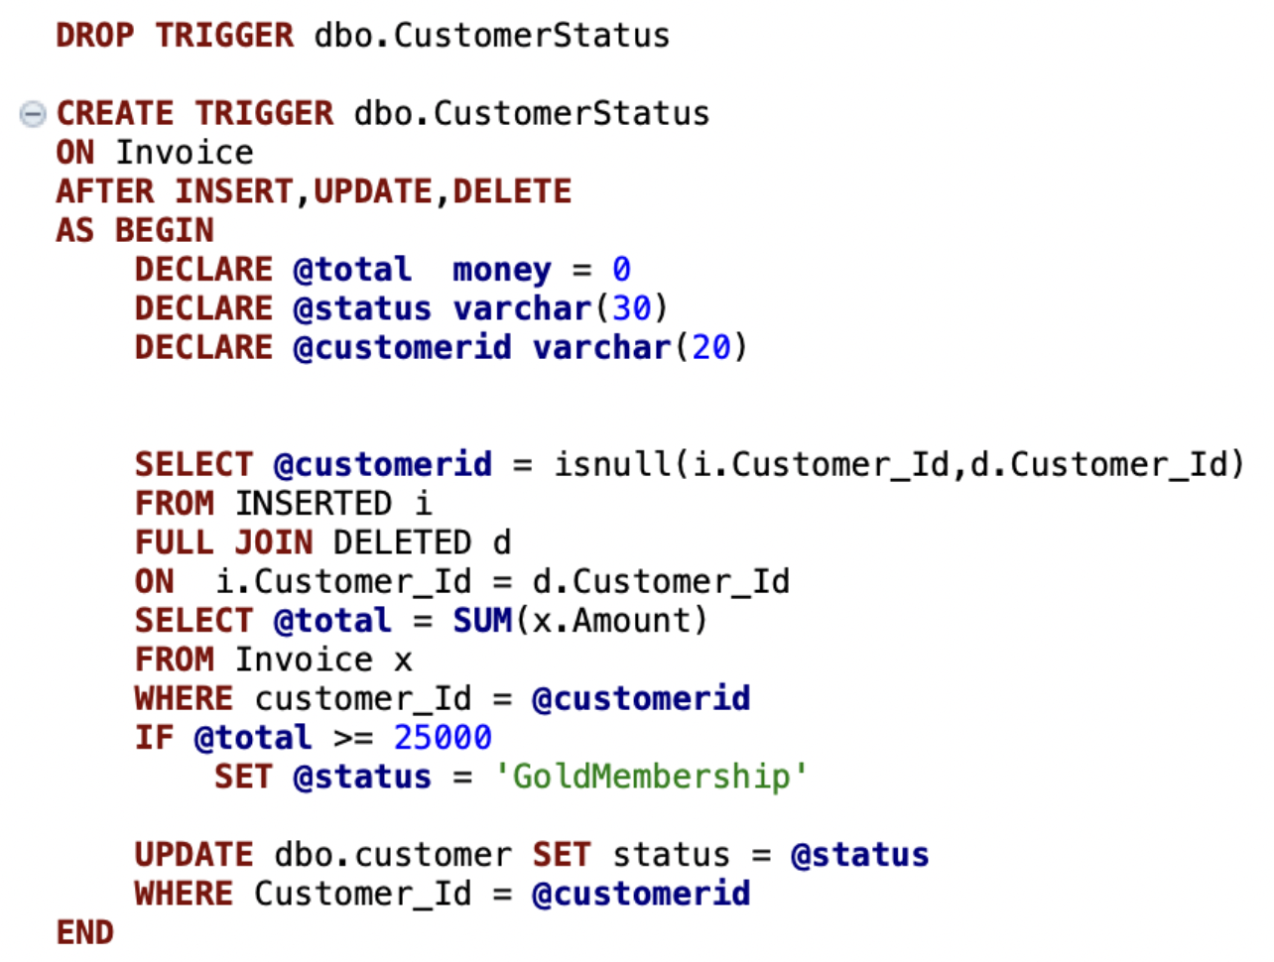
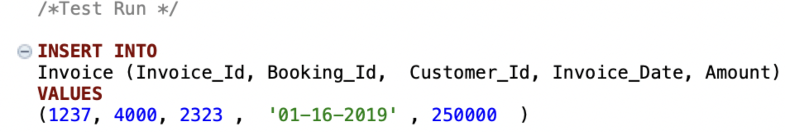
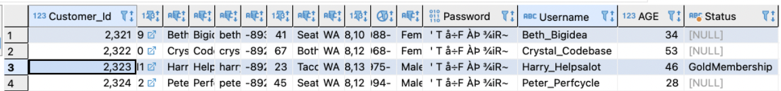
TRIGGER – To update Customer Status

Slide 18
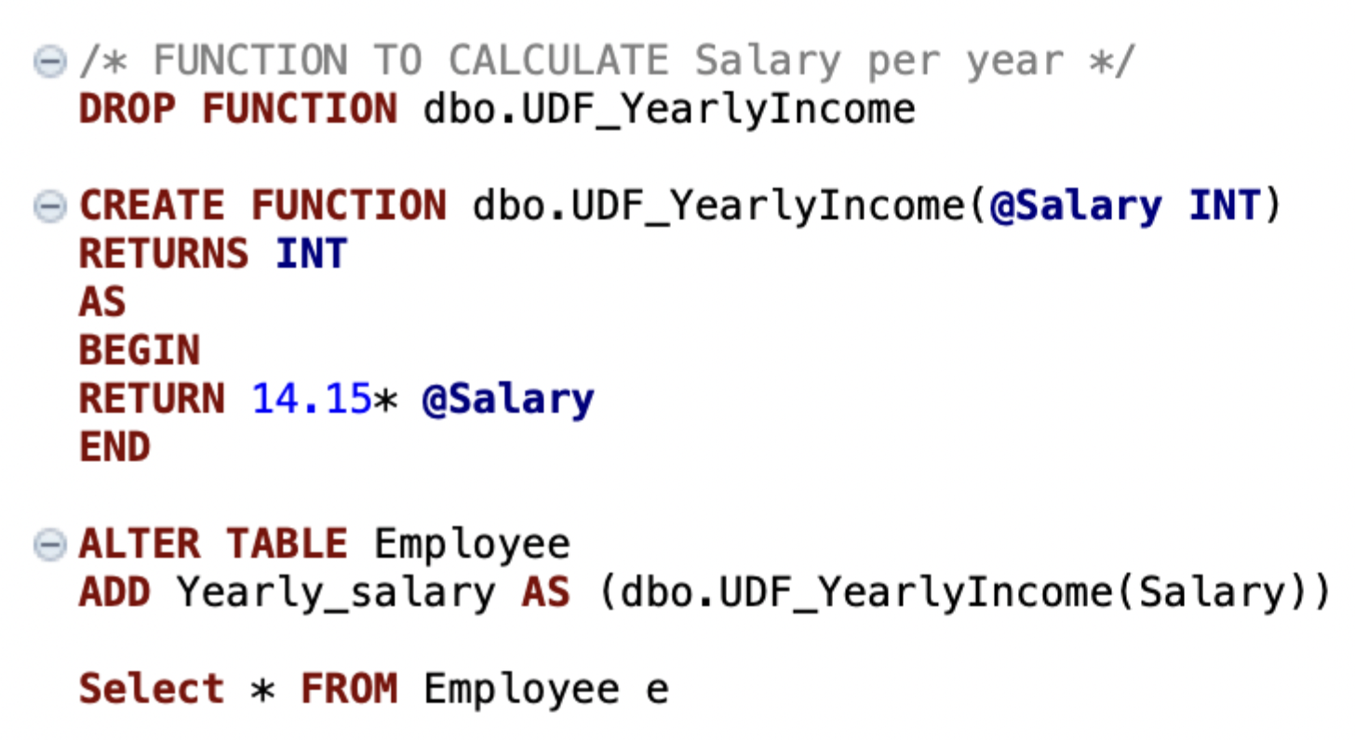
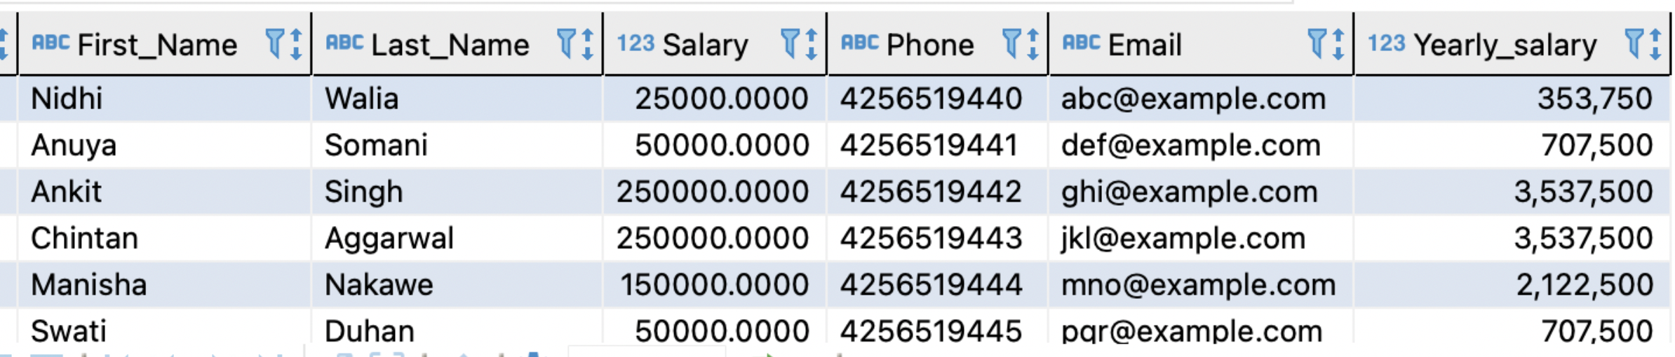
COMPUTED COLUMN BASED ON FUNCTION
Function to calculate the annual salary Employees

Slide 19
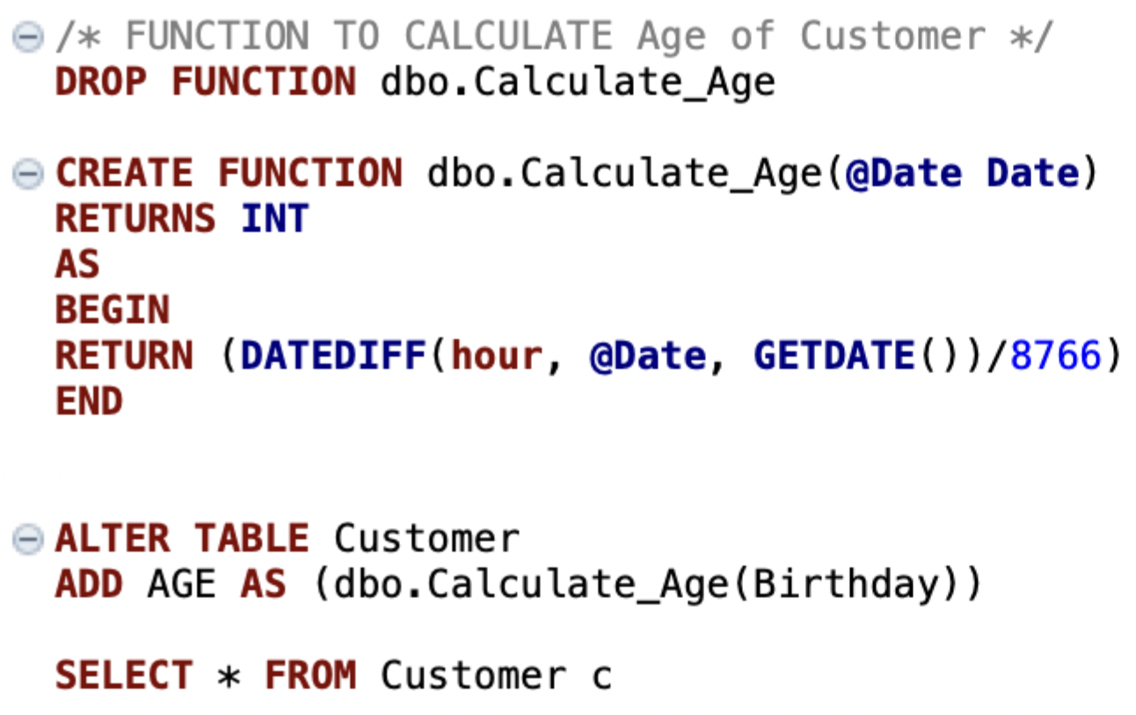
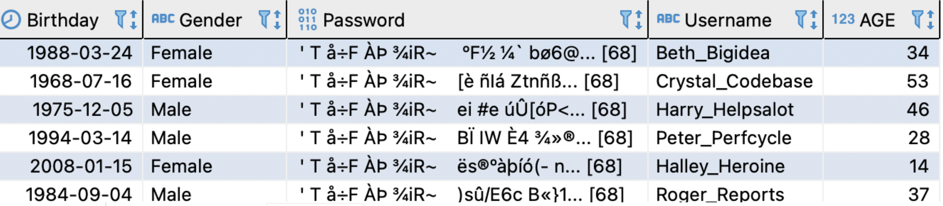
COMPUTED COLUMN BASED ON FUNCTION
Function to calculate the age of the Customer

Slide 20
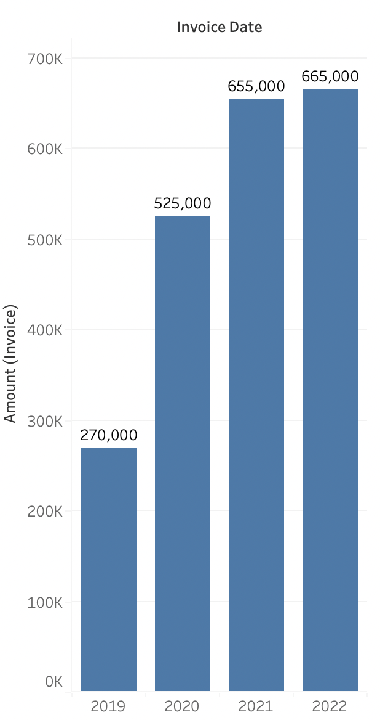
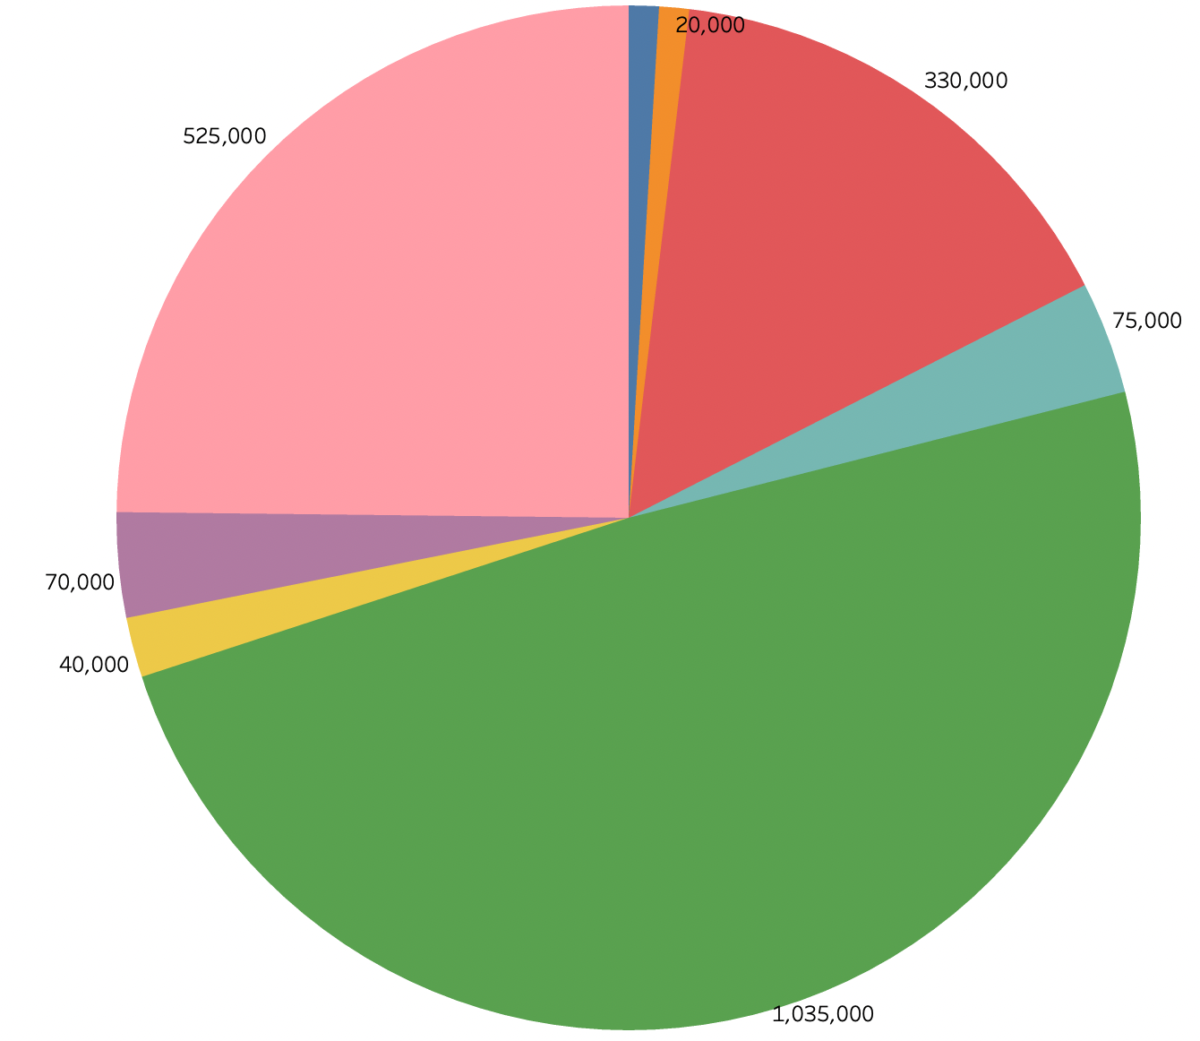
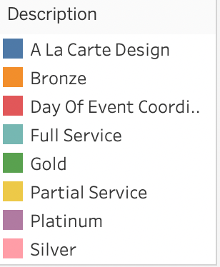
Maximum Sales in 4 Years
Most Popular Packages and their Revenue

Slide 21
CONCLUSION
We successfully implemented event management system database using triggers, functions, views and performed data analysis using a data mining tool Tableau.
The database is not limited to create only one report but different reports representing different data that is needed for different situations which will be crucial in data analysis for quality control and improvement.

Slide 22
SCOPE FOR FUTURE IMPROVEMENTS:
Allow customization of services to the customers
Send automated reminders to customers
Automation of database.
Planning to use Indexing technique to improve performance of database.

Slide 23


Slide 24

Q &A

